Slide 1

Chapter 9
Internet Control Message Protocol Version 4 (ICMPv4)
TCP/IP Protocol Suite
Copyright © The McGraw-Hill Companies, Inc. Permission required for reproduction or display.

Slide 2
OBJECTIVES:
To discuss the rationale for the existence of ICMP.
To show how ICMP messages are divided into two categories: error reporting and query messages.
To discuss the purpose and format of error-reporting messages.
To discuss the purpose and format of query messages.
To show how the checksum is calculated for an ICMP message.
To show how debugging tools using the ICMP protocol.
To show how a simple software package that implements ICMP is organized.
TCP/IP Protocol Suite

Slide 3
Chapter
Outline
9.1 Introduction
9.2 Messages
9.3 Debugging Tools
9.4 ICMP Package
TCP/IP Protocol Suite

Slide 4
9-1 INTRODUCTION
The IP protocol has no error-reporting or error correcting mechanism. What happens if something goes wrong? What happens if a router must discard a datagram because it cannot find a router to the final destination, or because the time-to-live field has a zero value? These are examples of situations where an error has occurred and the IP protocol has no built-in mechanism to notify the original host.
TCP/IP Protocol Suite

Slide 5
Topics Discussed in the Section
The position of ICMP in the TCP/IP suite
Encapsulation of ICMP Packets
TCP/IP Protocol Suite

Slide 6
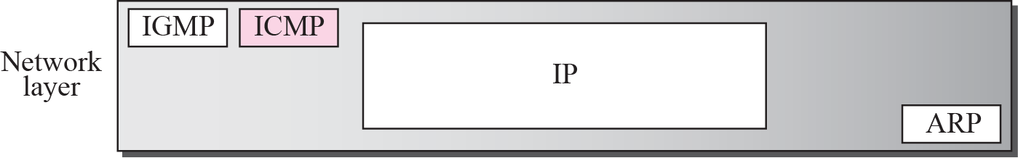
Figure 9.1 Position of ICMP in the network layer
TCP/IP Protocol Suite

Slide 7
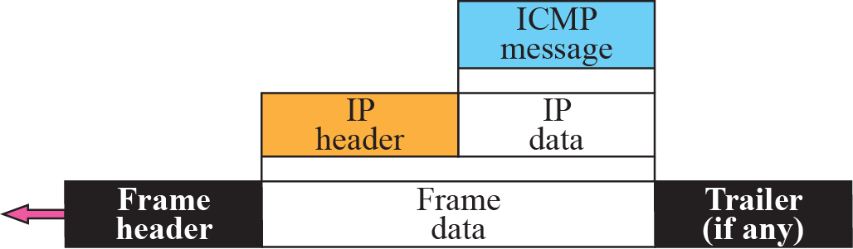
Figure 9.2 ICMP encapsulation
TCP/IP Protocol Suite

Slide 8
9-2 MESSAGES
ICMP messages are divided into two broad categories: error-reporting messages and query messages. The error-reporting messages report problems that a router or a host (destination) may encounter when it processes an IP packet. The query messages, which occur in pairs, help a host or a network manager get specific information from a router or another host. Also, hosts can discover and learn about routers on their network and routers can help a node redirect its messages.
TCP/IP Protocol Suite

Slide 9
Topics Discussed in the Section
Message Format
Error Reporting Messages
Query Messages
Checksum
TCP/IP Protocol Suite

Slide 10
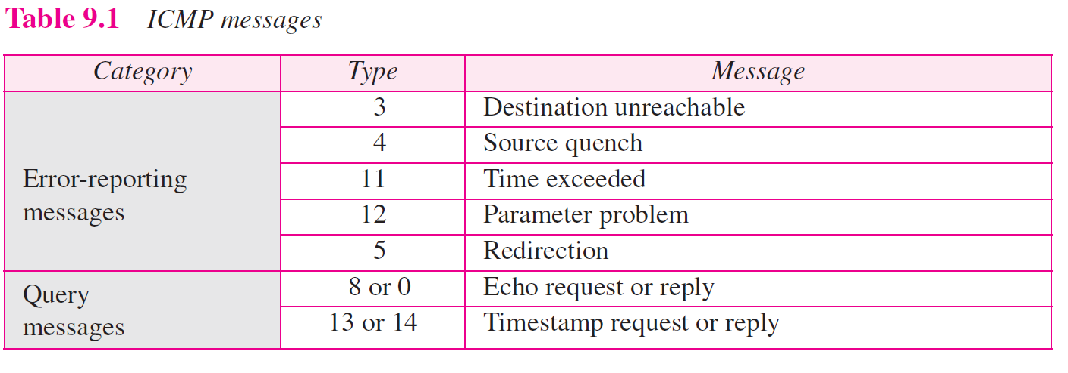
TCP/IP Protocol Suite

Slide 11
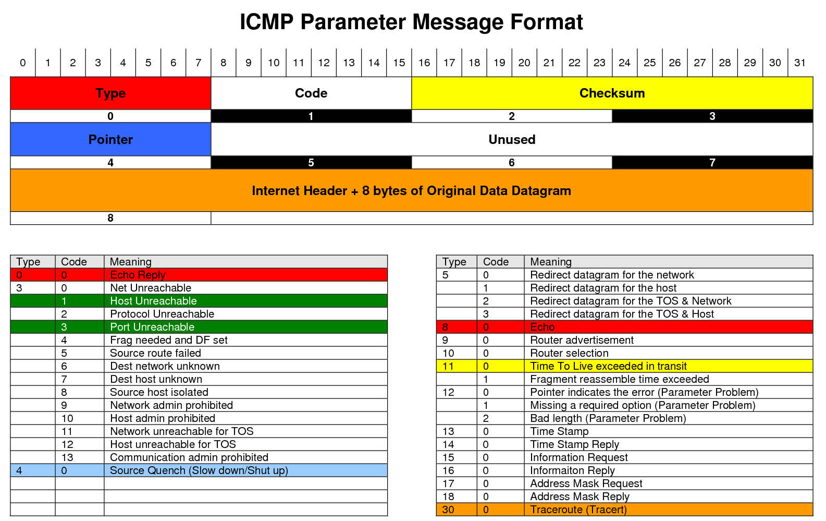
TCP/IP Protocol Suite

Slide 12
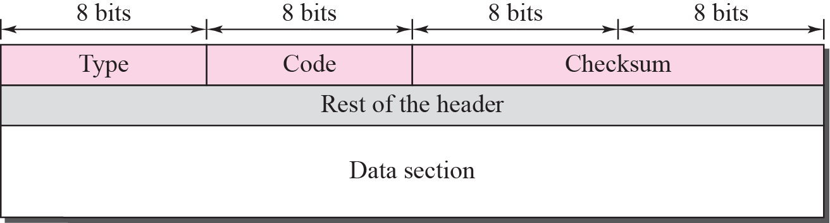
Figure 9.3 General format of ICMP messages
TCP/IP Protocol Suite

Slide 13

Note
ICMP always reports error messages to the original source.
TCP/IP Protocol Suite

Slide 14
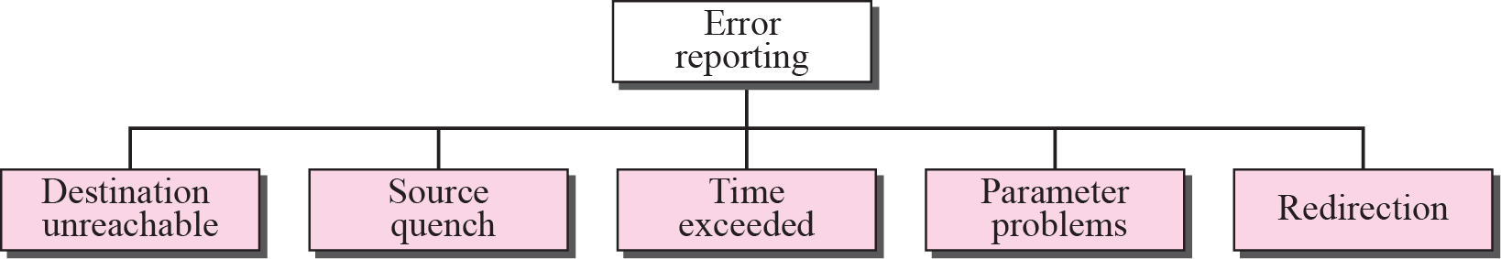
Figure 9.4 Error-reporting messages
TCP/IP Protocol Suite

Slide 15
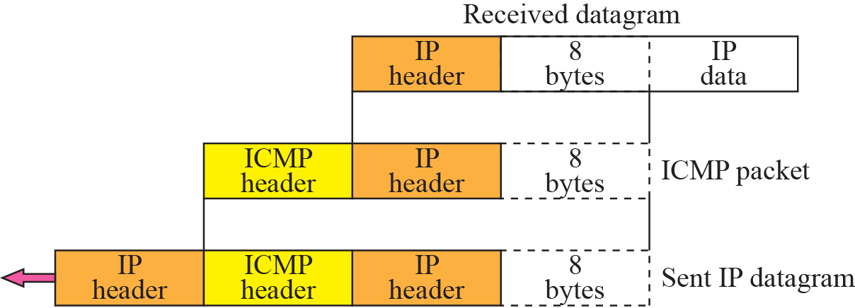
Figure 9.5 Contents of data field for the error message
TCP/IP Protocol Suite

Slide 16
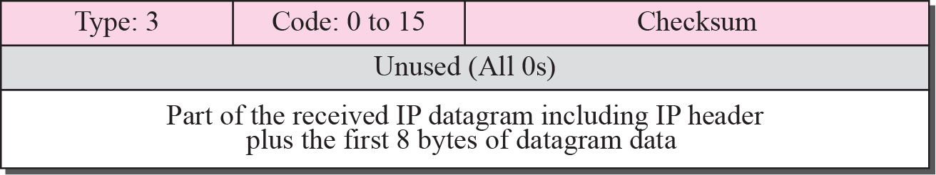
Figure 9.6 Destination-unreachable format
TCP/IP Protocol Suite

Slide 17
Note
Destination-unreachable messages with codes 2 or 3 can be created only by the
destination host.
Other destination-unreachable messages can be created only by routers.
TCP/IP Protocol Suite

Slide 18
Note
A router cannot detect all problems that prevent the delivery of a packet.
TCP/IP Protocol Suite

Slide 19
Note
There is no flow-control or congestion-control mechanism in the IP protocol.
TCP/IP Protocol Suite

Slide 20
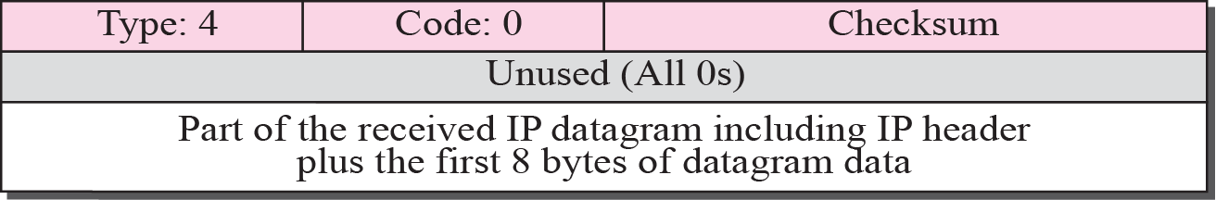
Figure 9.7 Source-quench format
TCP/IP Protocol Suite

Slide 21
Note
A source-quench message informs the source that a datagram has been discarded due to congestion in
a router or the destination host.
The source must slow down the sending of datagrams until the congestion is relieved.
TCP/IP Protocol Suite

Slide 22
Note
One source-quench message is sent for each datagram that is discarded due
to congestion.
TCP/IP Protocol Suite

Slide 23
Note
Whenever a router decrements a datagram with a time-to-live value to zero, it discards the datagram and
sends a time-exceeded message to the original source.
TCP/IP Protocol Suite

Slide 24
Note
When the final destination does not receive all of the fragments in a
set time, it discards the received fragments and sends a
time-exceeded message to
the original source.
TCP/IP Protocol Suite

Slide 25
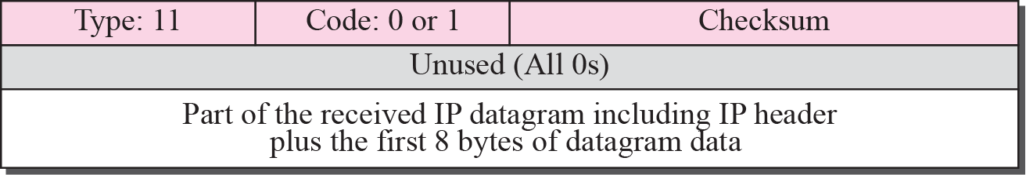
Figure 9.8 Time-exceeded message format
TCP/IP Protocol Suite

Slide 26
Note
In a time-exceeded message, code 0 is used only by routers to show that the value of the time-to-live field is zero.
Code 1 is used only by the destination host to show that not all of
the fragments have arrived
within a set time.
TCP/IP Protocol Suite

Slide 27
Note
A parameter-problem message can be created by a router or the destination host.
TCP/IP Protocol Suite

Slide 28
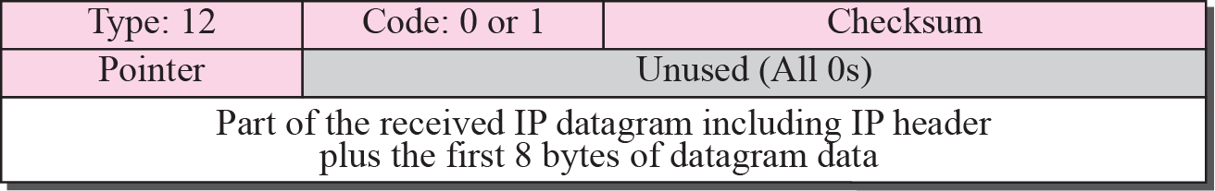
Figure 9.9 Parameter-problem message format
TCP/IP Protocol Suite

Slide 29
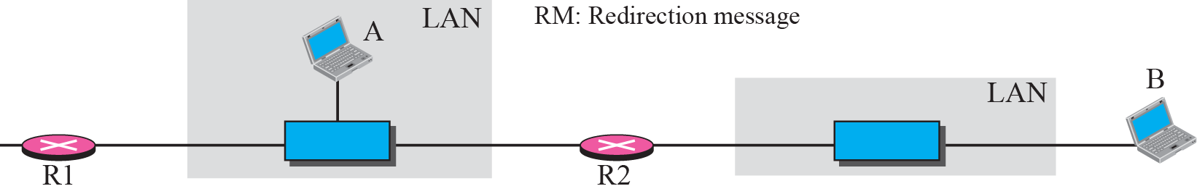
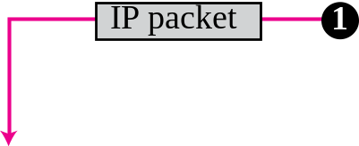

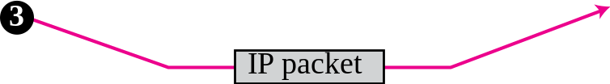
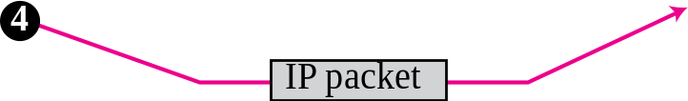
Figure 9.10 Redirection concept
TCP/IP Protocol Suite

Slide 30
Note
A host usually starts with a small routing table that is gradually augmented and updated.
One of the tools to accomplish this
is the redirection message.
TCP/IP Protocol Suite

Slide 31
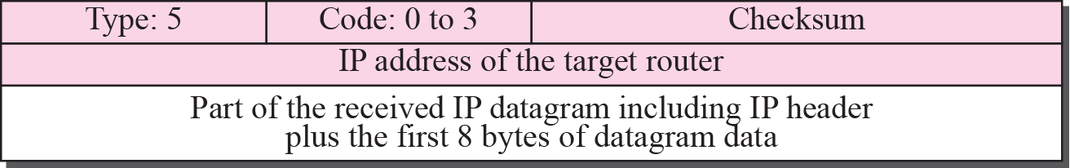
Figure 9.11 Redirection message format
TCP/IP Protocol Suite

Slide 32
Note
A redirection message is sent from a router to a host on the same local network.
TCP/IP Protocol Suite

Slide 33
Note
An echo-request message can be sent by a host or router.
An echo-reply message is sent
by the host or router that receives
an echo-request message.
TCP/IP Protocol Suite

Slide 34
Note
Echo-request and echo-reply messages can be used by network managers to check the operation of the IP protocol.
TCP/IP Protocol Suite

Slide 35
Note
Echo-request and echo-reply messages can test the reachability of a host.
This is usually
done by invoking the ping command.
TCP/IP Protocol Suite

Slide 36
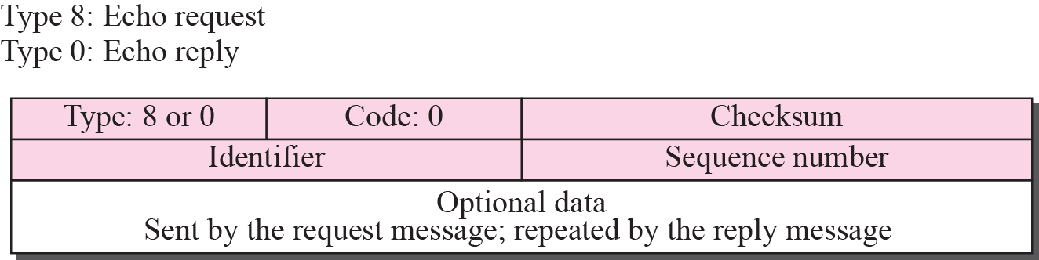
Figure 9.12 Echo-request and echo-reply message
TCP/IP Protocol Suite

Slide 37
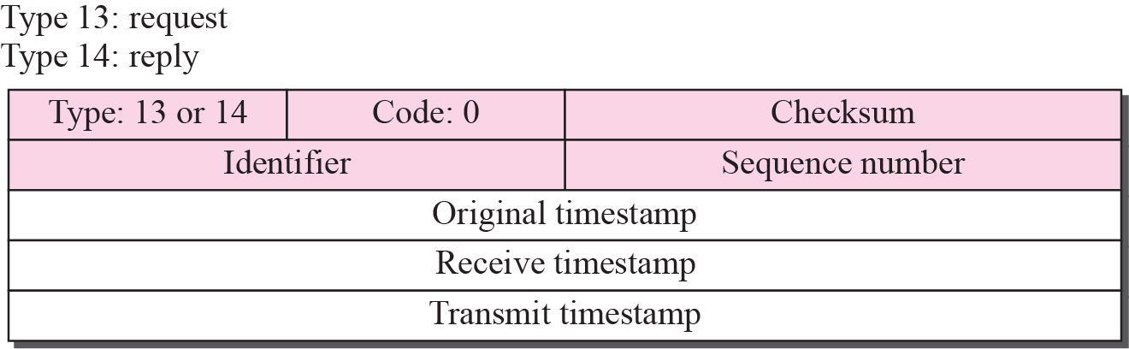
Figure 9.13 Timestamp-request and timestamp-reply message format
TCP/IP Protocol Suite

Slide 38
Note
Timestamp-request and timestamp-reply messages can be used to calculate the
round-trip time between a source and a destination machine even if their
clocks are not synchronized.
TCP/IP Protocol Suite

Slide 39
Note
The timestamp-request and timestamp-reply messages can be used to synchronize two clocks in two
machines if the exact one-way
time duration is known.
TCP/IP Protocol Suite

Slide 40
Example 9.1
Figure 9.14 shows an example of checksum calculation for a simple echo-request message (see Figure 9.12). We randomly chose the identifier to be 1 and the sequence number to be 9. The message is divided into 16-bit (2-byte) words. The words are added together and the sum is complemented. Now the sender can put this value in the checksum field.
TCP/IP Protocol Suite

Slide 41
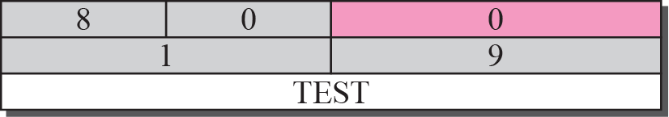

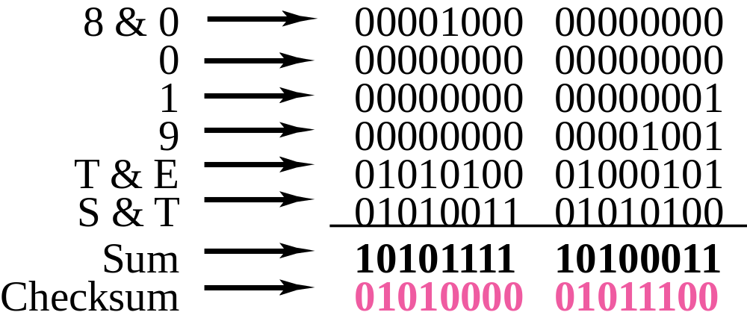
Figure 9.14 Example of checksum calculation
TCP/IP Protocol Suite

Slide 42
9-3 DEBUGGING TOOLS
There are several tools that can be used in the Internet for debugging. We can find if a host or router is alive and running. We can trace the route of a packet. We introduce two tools that use ICMP for debugging: ping and traceroute. We will introduce more tools in future chapters after we have discussed the corresponding protocols.
TCP/IP Protocol Suite

Slide 43
Topics Discussed in the Section
Ping
Traceroute
TCP/IP Protocol Suite

Slide 44
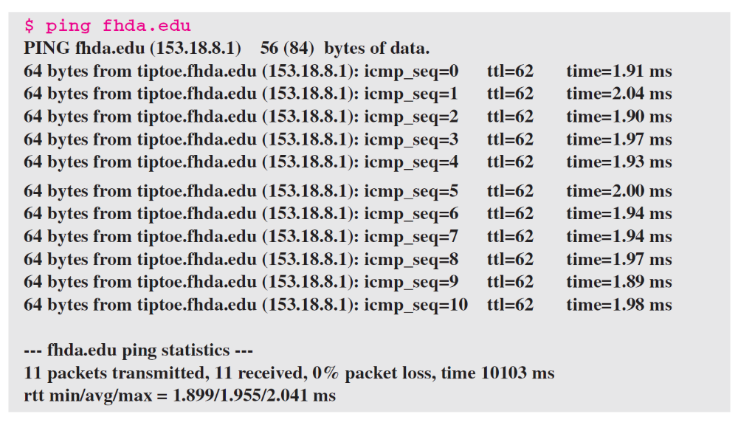
Example 9.2
We use the ping program to test the server fhda.edu. The result is shown below:
TCP/IP Protocol Suite

Slide 45
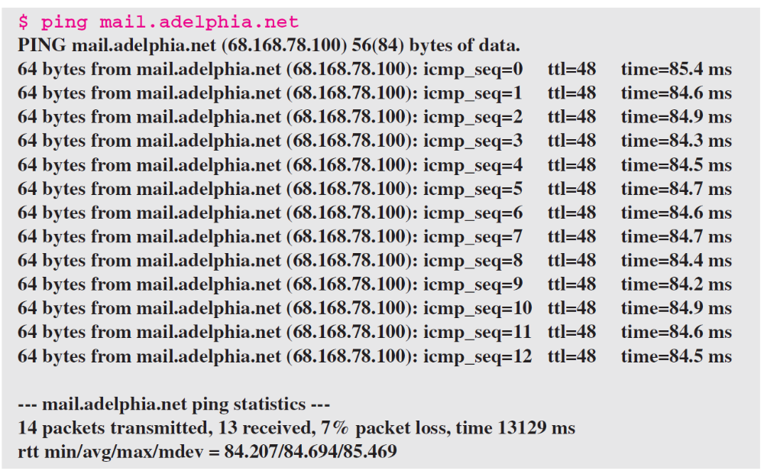
Example 9.3
For the second example, we want to know if the adelphia.net mail server is alive and running. The result is shown below: Note that in this case, we sent 14 packets, but only 13 have been returned. We may have interrupted the program before the last packet, with sequence number 13, was returned.
TCP/IP Protocol Suite

Slide 46
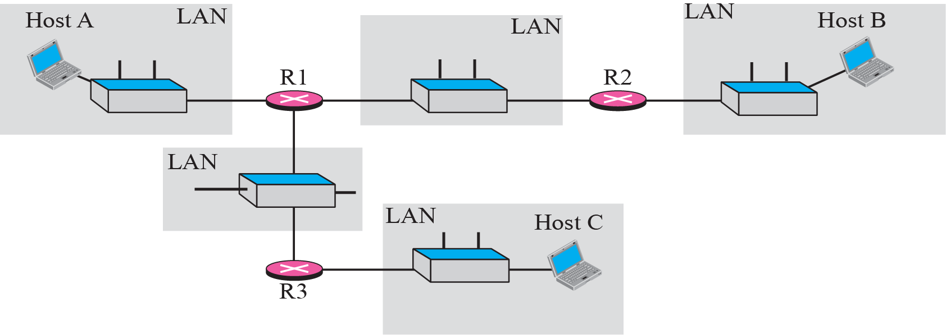
Figure 9.15 The traceroute program operation
TCP/IP Protocol Suite

Slide 47
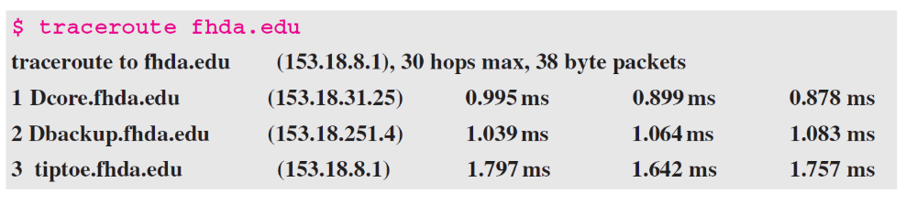
Example 9.4
We use the traceroute program to find the route from the computer voyager.deanza.edu to the server fhda.edu. The following shows the result.
TCP/IP Protocol Suite

Slide 48
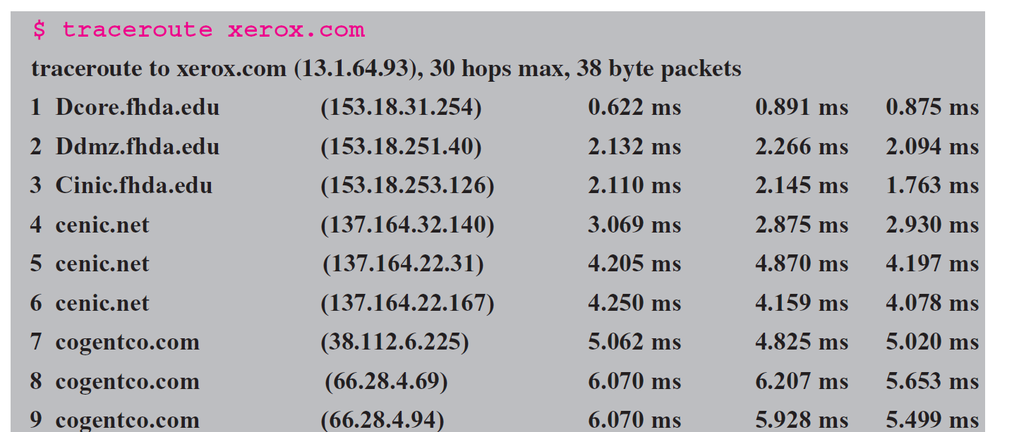
Example 9.5
In this example, we trace a longer route, the route to xerox.com. The following is a partial listing.
TCP/IP Protocol Suite

Slide 49
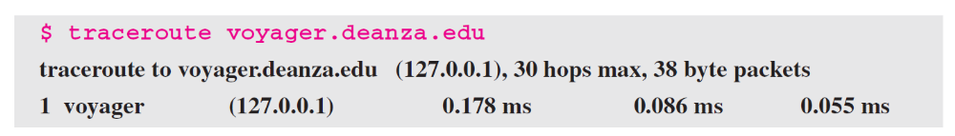
Example 9.6
An interesting point is that a host can send a traceroute packet to itself. This can be done by specifying the host as the destination. The packet goes to the loopback address as we expect.
TCP/IP Protocol Suite

Slide 50
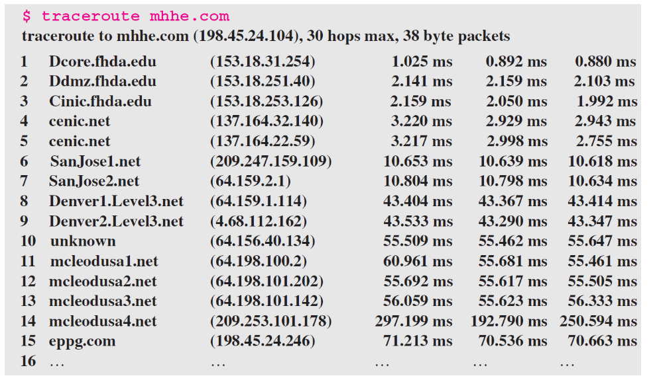
Example 9.7
Finally, we use the traceroute program to find the route between fhda.edu and mhhe.com (McGraw-Hill server). We notice that we cannot find the whole route. When traceroute does not receive a response within 5 seconds, it prints an asterisk to signify a problem (not the case in this example), and then tries the next hop.
TCP/IP Protocol Suite

Slide 51
9-4 ICMP PACKAGE
To give an idea of how ICMP can handle the sending and receiving of ICMP messages, we present our version of an ICMP package made of two modules: an input module and an output module.
TCP/IP Protocol Suite

Slide 52
Topics Discussed in the Section
Input Module
Output Module
TCP/IP Protocol Suite

Slide 53
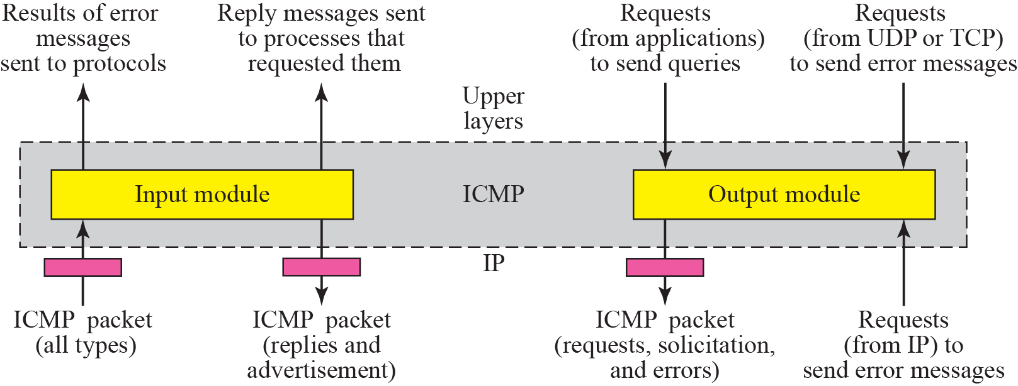
Figure 9.16 ICMP package
TCP/IP Protocol Suite

Slide 54
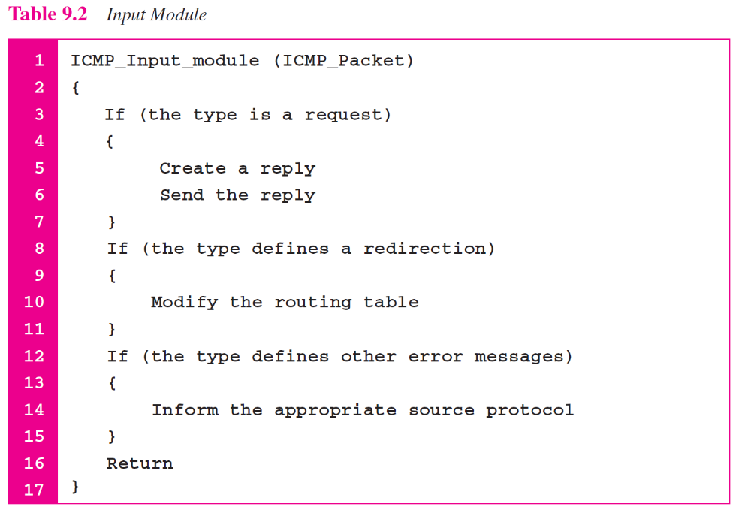
TCP/IP Protocol Suite

Slide 55
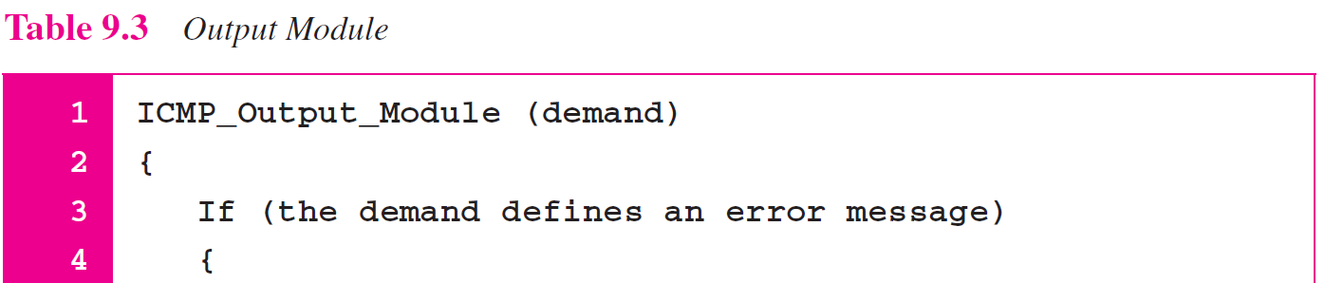
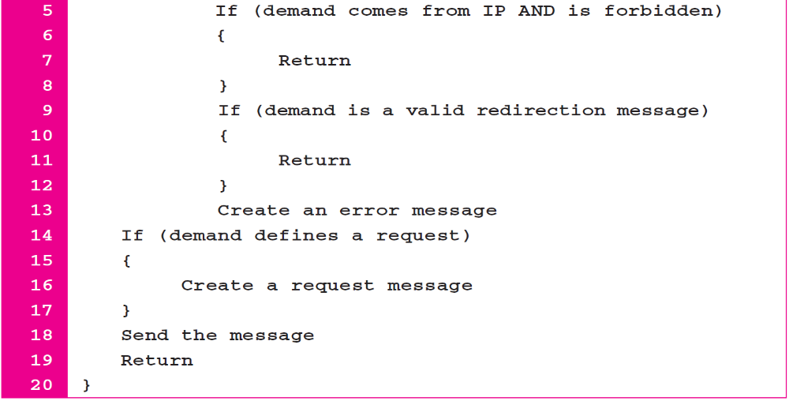
TCP/IP Protocol Suite

